Slide 1
Applied Data Science SVM - SUPPORT VECTOR MACHINES
Dr. Omri Allouche
2017

Slide 2
Linear Separators
Which of the linear separators is optimal?

Slide 3
Support vector machines
Find a hyperplane that maximizes the margin between the positive and negative examples
For support vectors,
Distance between point and hyperplane:
Therefore, the margin is 2 / ||w||
Support vectors
Margin

Slide 4
Classification Margin
ρ
Distance from example x_{i} to the separator is
Examples closest to the hyperplane are support vectors
Margin ρ of the separator is the distance between support vectors
r

Slide 5
Finding the maximum margin hyperplane
Maximize margin 2 / ||w||
Correctly classify all training data:
Quadratic optimization problem:
C. Burges, A Tutorial on Support Vector Machines for Pattern Recognition, Data Mining and Knowledge Discovery, 1998

Slide 6
Nonlinear SVMs
General idea: the original input space can always be mapped to some higher-dimensional feature space where the training set is separable:
Φ: x → φ(x)
Slide credit: Andrew Moore

Slide 7
Nonlinear SVMs
The kernel trick: instead of explicitly computing the lifting transformation φ(x), define a kernel function K such that K(x_{i} , x_{j}) = φ(x_{i} ) · φ(x_{j})
To be valid, the kernel function must satisfy Mercer’s condition:
This gives a nonlinear decision boundary in the original feature space.

Slide 8
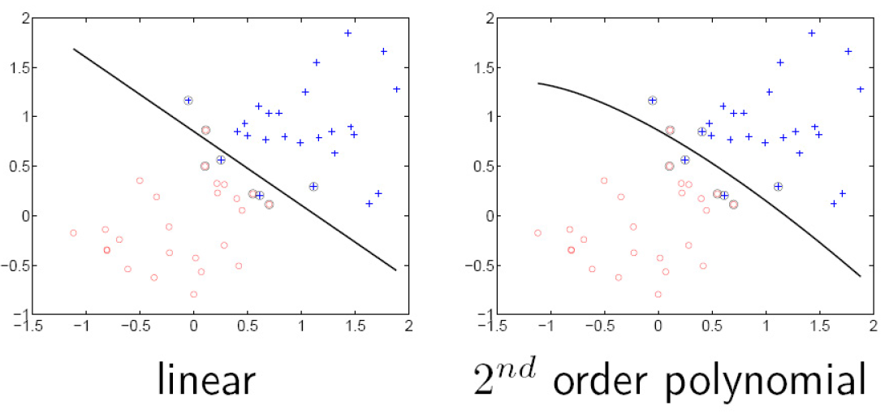
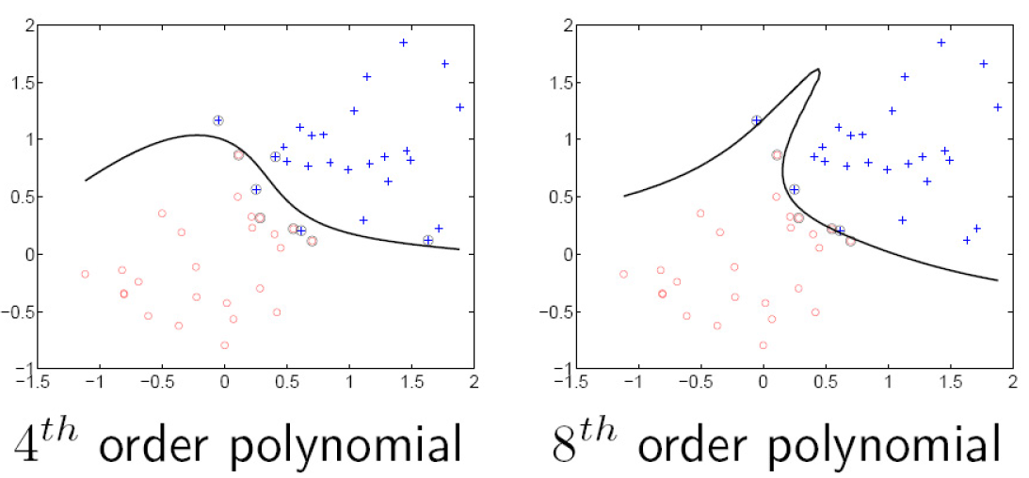
Polynomial kernel:

Slide 9
Datasets that are linearly separable work out great:
But what if the dataset is just too hard?
We can map it to a higher-dimensional space:
0
x
0
x
x²
0
x
Slide credit: Andrew Moore

Slide 10
Nonlinear kernel: Example
Consider the mapping
x²

Slide 11




Examples of Kernel Functions
Linear:
Polynomial of power d:
Gaussian (radial-basis function network):
Sigmoid:

Slide 12
What about multi-class SVMs?
There is no “definitive” multi-class SVM formulation
Multi-class SVM combines multiple two-class SVMs
One vs. others
Training: learn an SVM for each class vs. the others
Testing: apply each SVM to test example and assign to it the class of the SVM that returns the highest decision value
One vs. one
Training: learn an SVM for each pair of classes
Testing: each learned SVM “votes” for a class to assign to the test example
Slide credit: L. Lazebnik

Slide 13
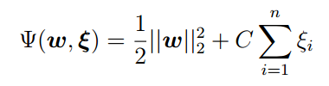
Soft Margin SVM
Optimize a combination – maximize margin + minimize errors
The parameter C determines the cost of errors
Introduces “slack” variable, that accounts for the non-separability of data

Slide 14
Properties of SVM
Works well in practice
Convex function, therefore guaranteed global optimization
Works well with small number of observations
Effective when # observations < # features
Flexibility in choosing a kernel
Overfitting can be controlled by soft margin approach
Ability to handle large feature spaces
only support vectors are used to specify the separating hyperplane
complexity does not depend on the dimensionality of the feature space
Heavy on Computation & memory
During training time, must compute matrix of kernel values for every pair of examples
Learning can take a very long time for large-scale problems
Sensitive to outliers/mislabels
Doesn’t provide probabilities of belonging to a class

Slide 15
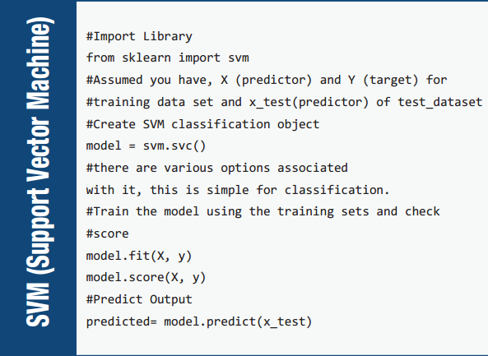

Slide 16

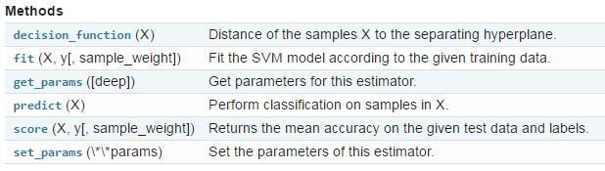
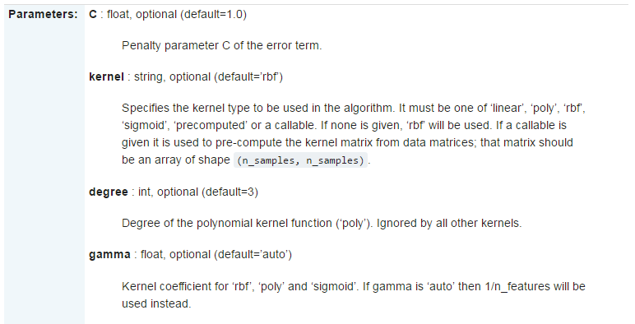

Slide 17
Hyper-Parameters Optimization
Train-develop-test sets
Grid search
“Learning” the optimal parameters

